Slide 1
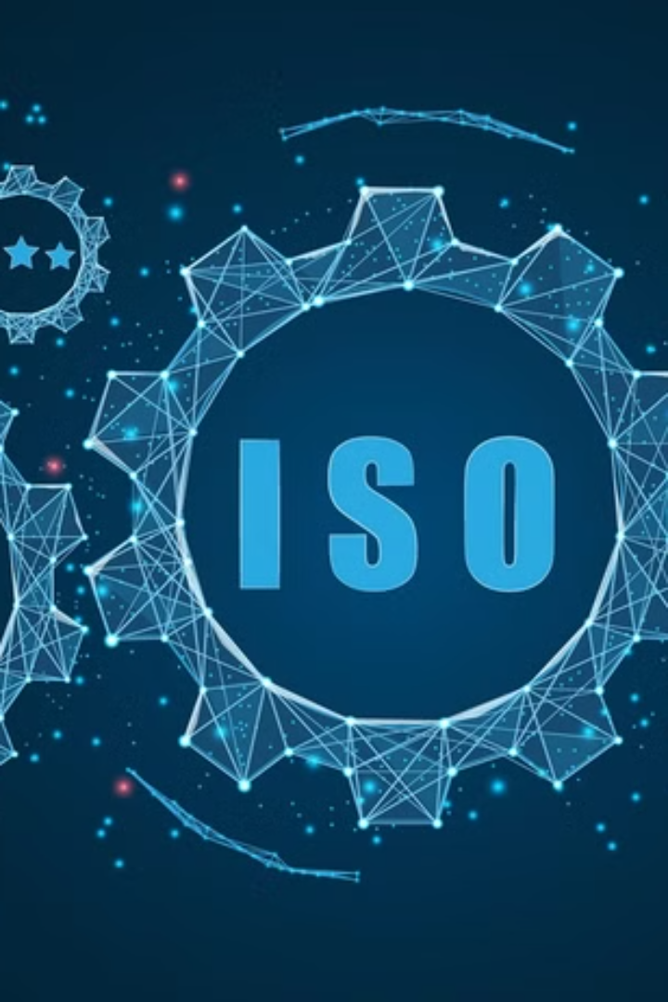

ISO 27001 Implementation Toolkit
Comprehensive guide for securing information systems.
Thilakarathna S.T.D, IT22578914

Slide 2
Introduction to ISO 27001
International Standard
Risk Management Framework
Data Protection
Information Security Management Systems (ISMS).
Confidentiality, integrity, and availability of data.
Identify risks, manage controls, continuous improvement.

Slide 3

Importance of ISO 27001
Cyber Threat Mitigation
Trust and Confidence
Reduce risk of data breaches and attacks.
Build stronger relationships with stakeholders.
Compliance
Business Continuity
Meet legal and regulatory requirements.
Improve resilience through risk management.

Slide 4
ISO 27001 Implementation Roadmap
Scope Definition
1
Identify systems and data.
2
Risk Assessment
Analyze threats and vulnerabilities.
Policy Development
3
Establish security controls.
4
Employee Training
Raise awareness and skills.
Internal Audits
5
Monitor compliance and effectiveness.
6
Certification Preparation
Prepare for audit and obtain certification.

Slide 5
Essential ISO 27001 Documents
Project Plan
Document Control
ISMS Scope
Roadmap for implementation.
Manage and track documentation.
Define systems and data covered.
Security Policy
Risk Assessment
Risk Register
Overall security guidelines.
Identify and evaluate threats.
Track risks and mitigation plans.
Statement of Applicability
Asset Inventory
Internal Audit Procedure
Choose applicable controls.
Identify and categorize assets.
Conduct periodic assessments.
Management Review
Awareness and Training
Track progress and effectiveness.
Educate employees on security.

Slide 6
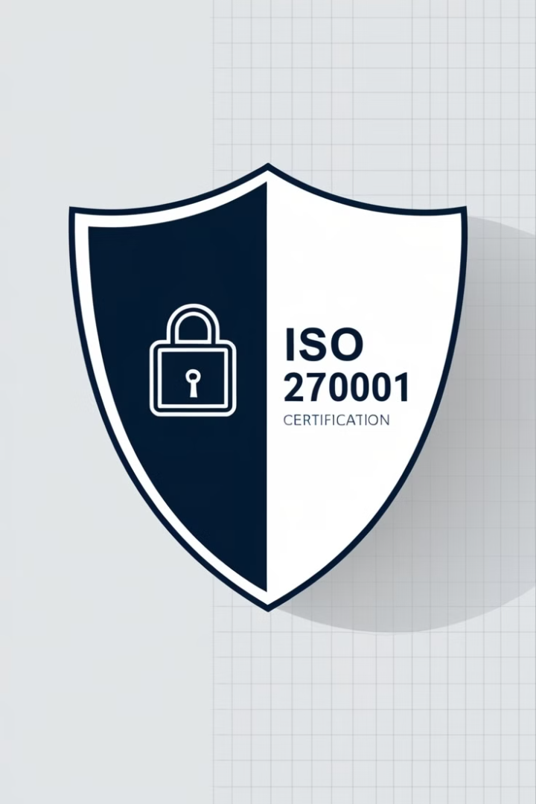
Challengers and Solutions
Challengers
Solutions
Resistance to change
Clear Communication
Resource constraints
Top management support
Complex Documentation
Simplify Documentation

Slide 7

Why Certification is Worth It
1
2
Reputation
Advantage
Enhanced customer trust.
Competitive edge in the market.
3
4
Efficiency
Compliance
Improved risk management and operational efficiency.
Legal compliance and reduced liability.

Slide 8



Conclusion
Information Security
1
Comprehensive approach.
Toolkit Support
2
Simplified implementation.
Business Benefits
3
Long-term growth.

Slide 9
Thank You!
Thilakarathna S.T.D, IT22578914

